Slide 1
COL
Council on Legislation
District representatives for the term covering 1 July 2020 through 30 June 2023.
2022 Council on Legislation

Slide 2
COR
Councils on Resolutions
District representatives for the term covering 1 July 2020 through 30 June 2023
2020, 2021, and 2022 Councils on Resolutions

Slide 3
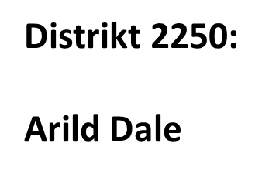
COL
Council on Legislation
Every three years, Rotarians meet at the Council on Legislation to review and vote on proposed changes to the legislation that governs Rotary. They consider enactments, which change Rotary’s governing documents, and position statements by the RI Board

Slide 4
COR
Councils on Resolutions
Proposing legislation and resolutions
Clubs, districts, the RI Board, and the RIBI general council or conference may submit legislation and resolutions to the Councils.
2021 COR: 30 June 2021
2022 COL: 31 December 2020
Distrikt 2250:
Arild Dale

Slide 5
COL/COR
Guvernørens ansvar
Påse at Distriktet etterlever RI’s lovverk
Påse at klubbene etterlever RI’s lover og regler
Distrikt 2250:
Arild Dale

Slide 6
COL/COR
Klubbpresidentens ansvar
Kjenne til at her er et regelverk for RI
Vite hvor klubben kan rette henvendelser ang lovverk og regler
Påse at Klubben etterlever RI’s lover og regler
Distrikt 2250:
Arild Dale

